Slide 1
MODIS Optical Global Water Information System (MOGWAI)
Measuring Lake and Reservoir Area from Optical Satellites

Slide 2
MOGWAI – lake/reservoir area monitoring
The MOGWAI system, as implemented by USACE, is based on a US Geological Survey (USGS) algorithm published in MDPI Remote Sensing Journal (both journal articles are available as open access):
Jones, J. W. (2015). Efficient wetland surface water detection and monitoring via landsat: Comparison with in situ data from the everglades depth estimation network. Remote Sensing, 7(9). https://doi.org/10.3390/rs70912503
Jones, J. W. (2019). Improved automated detection of subpixel-scale inundation-revised Dynamic Surface Water Extent (DSWE) partial surface water tests. Remote Sensing, 11(4). https://doi.org/10.3390/rs11040374
Landsat Level 3 Dynamic Surface Water Extent (DSWE) Science Products courtesy of the U.S. Geological Survey. https://www.usgs.gov/centers/eros/science/usgs-eros-archive-landsat-collection-2-level-3-dynamic-surface-water-extent
The Original algorithm (Dynamic Surface Water Extent - DSWE) uses LANDSAT satellite data from NASA/USGS; MOGWAI is a modified version of DWSE that uses MODIS satellite data

Slide 3
MOGWAI Description and Applications
The algorithm computes an area value (square kilometers) for the water body being evaluated
Computes inundation maps for pixels that are “partially surface water” and fully inundated.
Modified Normalized Difference Water Index (MNDWI)
Partial Surface Water Extent (PSW) – pixels that may contain both surface water and vegetation, partial water pixels (shore/coast), etc.
The satellite-based algorithm was initially designed to operate in the Florida Everglades where vegetation impacts the effectiveness of the NDWI algorithm
Once the area value is generated, it can be compared historically to previous lake area computations to understand impacts of drought on lake/reservoir water storage
When the area value is combined with bathymetry data, a storage volume can be estimated and used in hydrologic/hydraulic models

Slide 4
MOGWAI: Method
Uses NASA MODIS optical data product MOD09Q1.006 & MOD09A1.006
MOD09Q1: 250-meter resolution, 620-670 nm (red) & 841-876 nm (NIR) band data
MOD09A1: 500-meter resolution, Band 1 (red), Band 3 (blue), Band 4 (green), Band 2 (NIR), and SWIR bands 6, 7
Downloads data from USGS server at: https://e4ftl01.cr.usgs.gov/MOLT/MOD09Q1.006/
Algorithm utilizes MODIS cloud & snow mask products
To detect a water pixel, the satellite image must be cloud & snow free
Three step process:
Computes a Modified Normalized Differential Water Index (MNDWI)
DSWE then compares the MNDWI values to Band 4 and Band 7. If thresholds are met then the pixel is considered “inundated”.
Computes Partial Surface Water values from pixels that are not completely water points
Contains tests to diagnose surface water in vegetated satellite pixels

Slide 5
The MOGWAI Satellite Retrieval Algorithm Tests
Modified Normalized Differential Water Index
(GreenB - SWIR1B) / (GreenB + SWIR1B)
Partial Surface Water Test 1
MNDWI > -0.44, NIR Band < 1500 and SWIR band < 900 and NDVI < 0.7
Partial Surface Water Test 2
MNDWI > -0.5, SWIR1 < 3000, SWIR2 < 1000, NIR < 2500, Blue < 1000
Multi-Band Spectral Relationship
Green + Red bands > the NIRB + SWIR1B bands
Automated Water Extent Shadow
(Green Band * AWE_param1) + (MBSRN * AWE_param2) + (SWIR * AWE_param3) + Blue band reflectance
Compute Normalized Difference Vegetation Index:
((NIRB - RedB) / (NIRB + RedB))

Slide 6
The MOGWAI Satellite Retrieval Algorithm Tests
Pixel Value | Threshold | Interpretation
00000 | N/A | No conditions met
00001 | MNDWI > 0.124 | MNDWI greater than Wetness Index threshold
00010 | MBSRV > MBSRN | MBSRV (green + red) greater than MBSRN (NIR + SWIR1)
00100 | AWEsh > 0.0 | Automated Water Extension Shadow (AWEsh) equation returns a value greater than Automated Water Extent Shadow Threshold (0)
01000 | MNDWI > -0.44 & SWIR1 < 900 & NIR < 1500 & NDVI < 0.7 | Partial Surface Water 1 (PSW1) equations meet specific thresholds
10000 | MNDWI > -0.5 & SWIR1 < 3000 & SWIR2 < 1000 & NIR < 2500 & Blue < 1000 | Partial Surface Water 2 (PSW2) equations meet specific thresholds

Slide 7
The MOGWAI Algorithm Results Matrix
Result Options | Threshold | Interpretation
0 | 0-1 tests true (0, 1, 10, 100, 1000) | Not water
1 | If 4 or 5 of the tests are true (1111, 10111, 11011, 11101, 11110, 11111) | Water high confidence
2 | 3 tests true (111, 1011, 1101, 1110, 10011, 10101, 10110, 11001, 11010, 11100) | Water moderate confidence
3 | PSW1 and PSW2 tests are true (11000) | Potential wetland
4 | 1-2 tests true (11, 101, 110, 1001, 1010, 1100, 10000, 10001, 10010, 10100) | Water or wetland (low confidence)

Slide 8
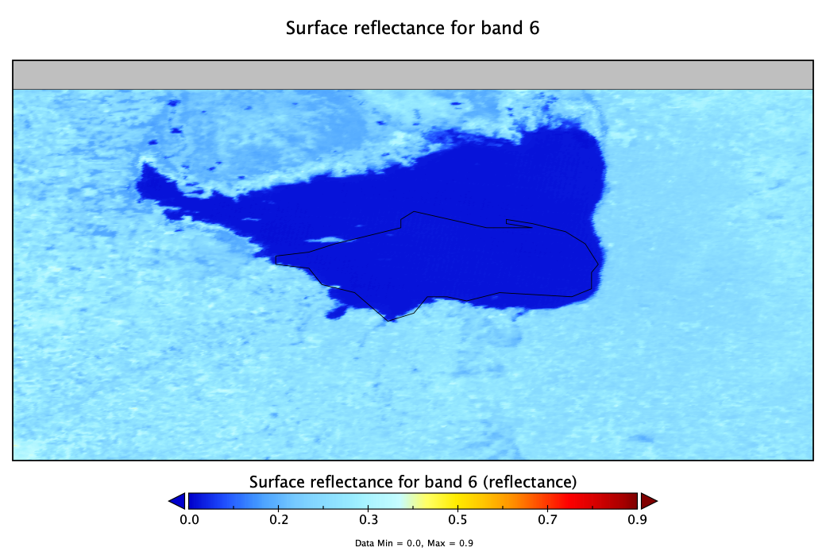
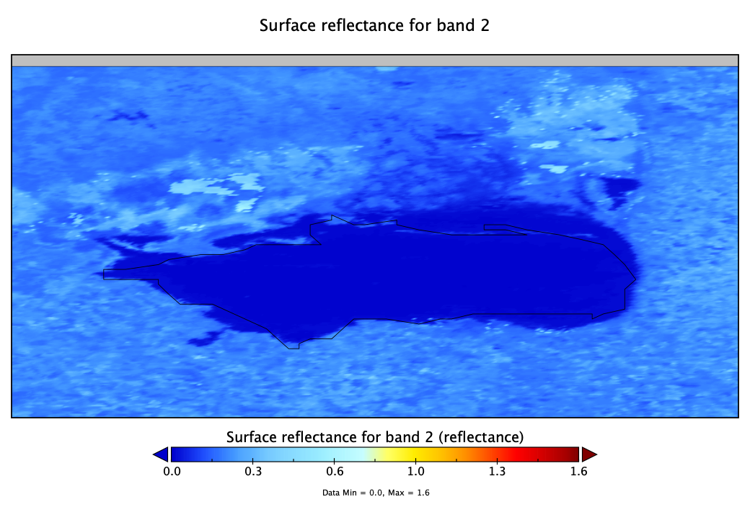
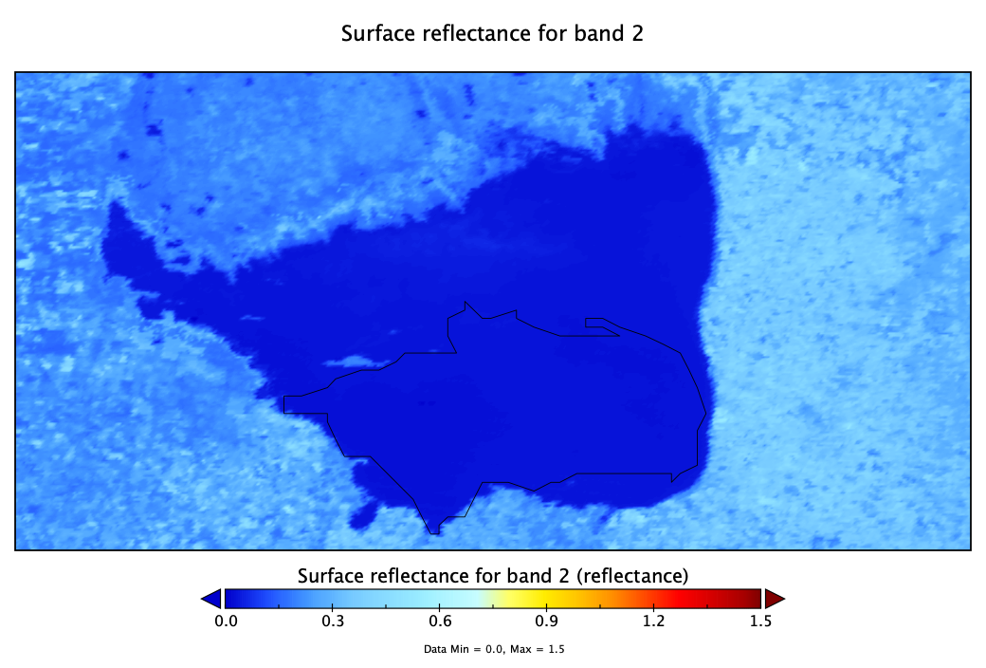
MODIS Spectral Band Examples
July, 2005
SWIR
Laguna Mar Chiquita, Argentina
Blue/Visible
July, 2005
Blue/Visible

Slide 9
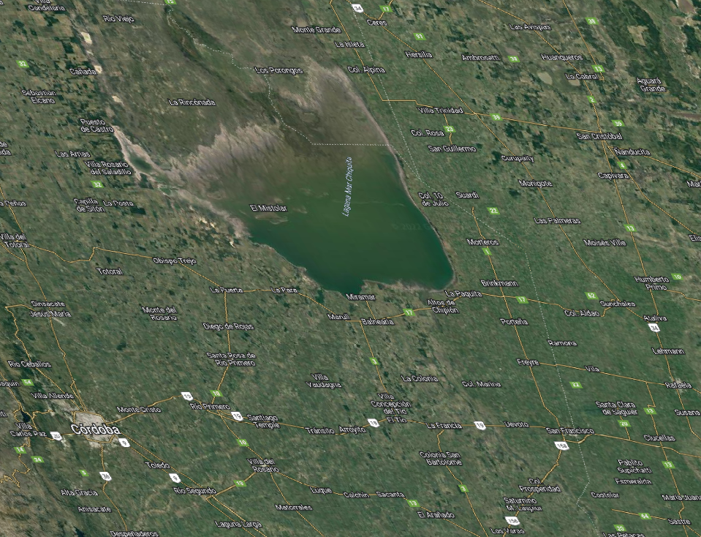
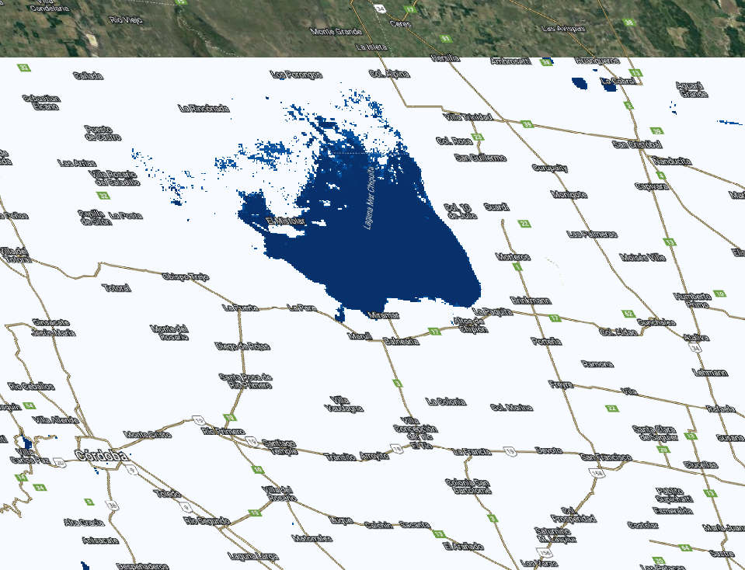
MOGWAI Results
Results viewed in QGIS software, with Google Earth satellite imagery for reference (MOGWAI results in right image)
July, 2022
Blue area – surface water detected

Slide 10
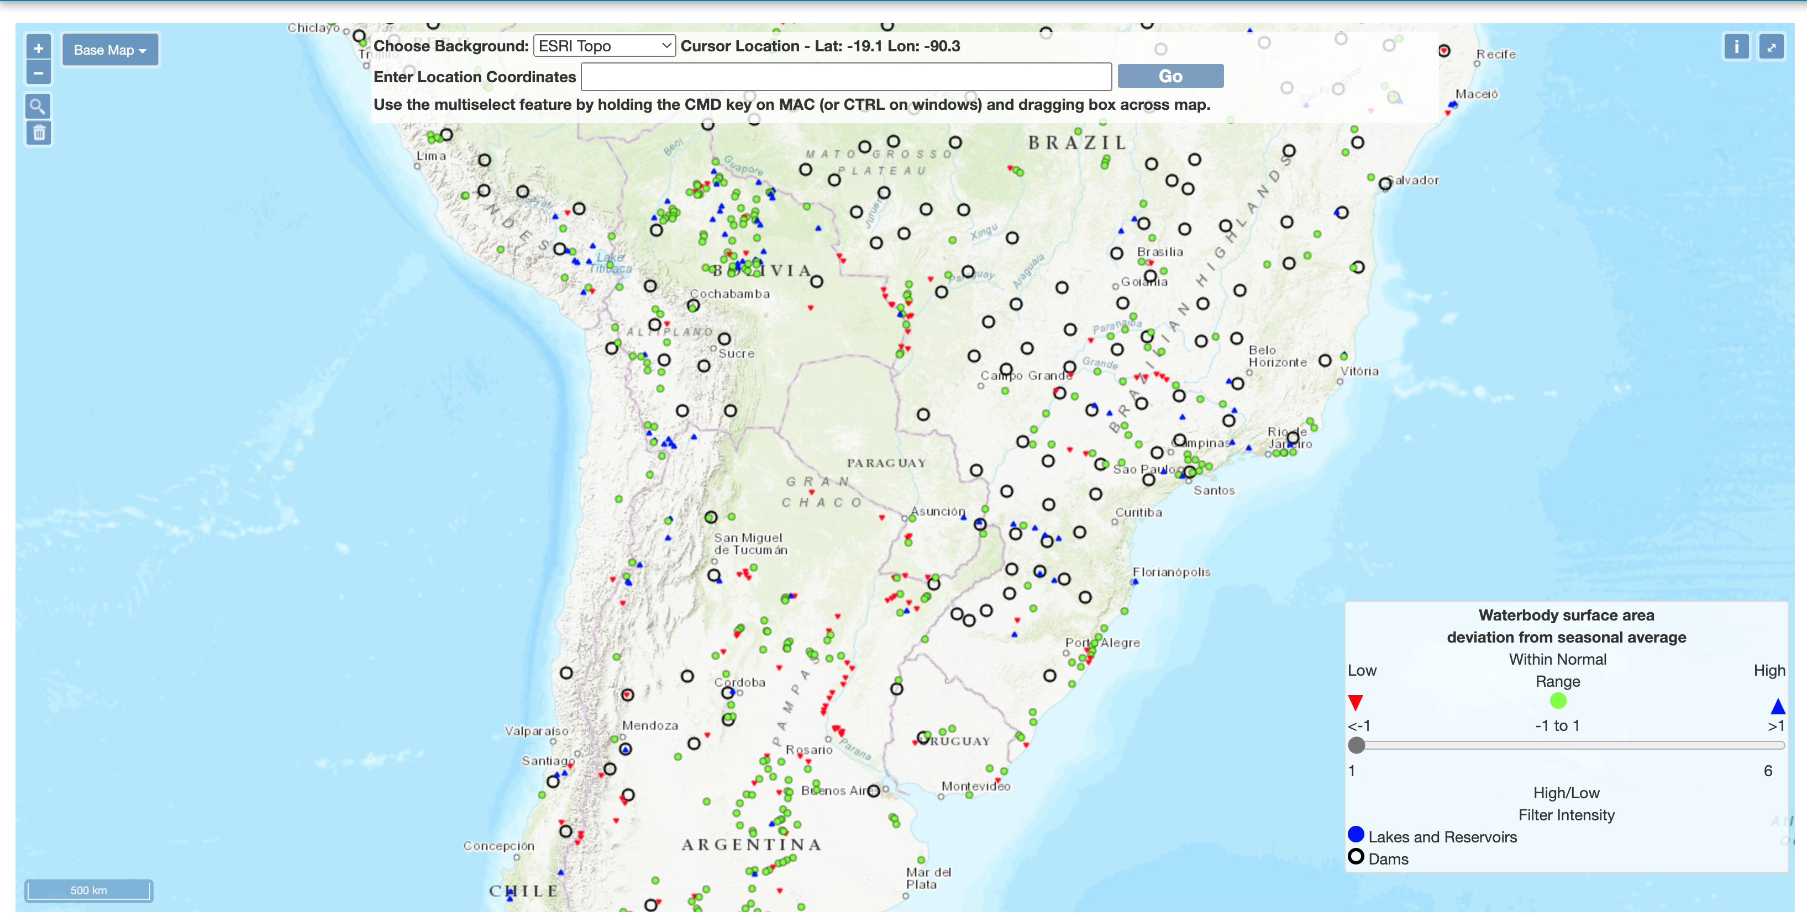
MOGWAI
USACE MOGWAI GIS-Enabled Web User Interface
Notes:
Reservoir and lake assessment module allows for automated delineation of surface water extent and tracks variability over time.
Joint effort between ERDC and National Geospatial-Intelligence Agency (NGA)
Two validated algorithms apply different approaches to water pixel classification on MODIS imagery
Independently assessed by United States Geological Survey (USGS)
Temporal profile (time series) of surface water extent/area enhanced by dynamically updating current estimates as new imagery becomes available
This provides historical and near real-time (~8-day latency) information regarding reservoir stocks around the world.

Slide 11
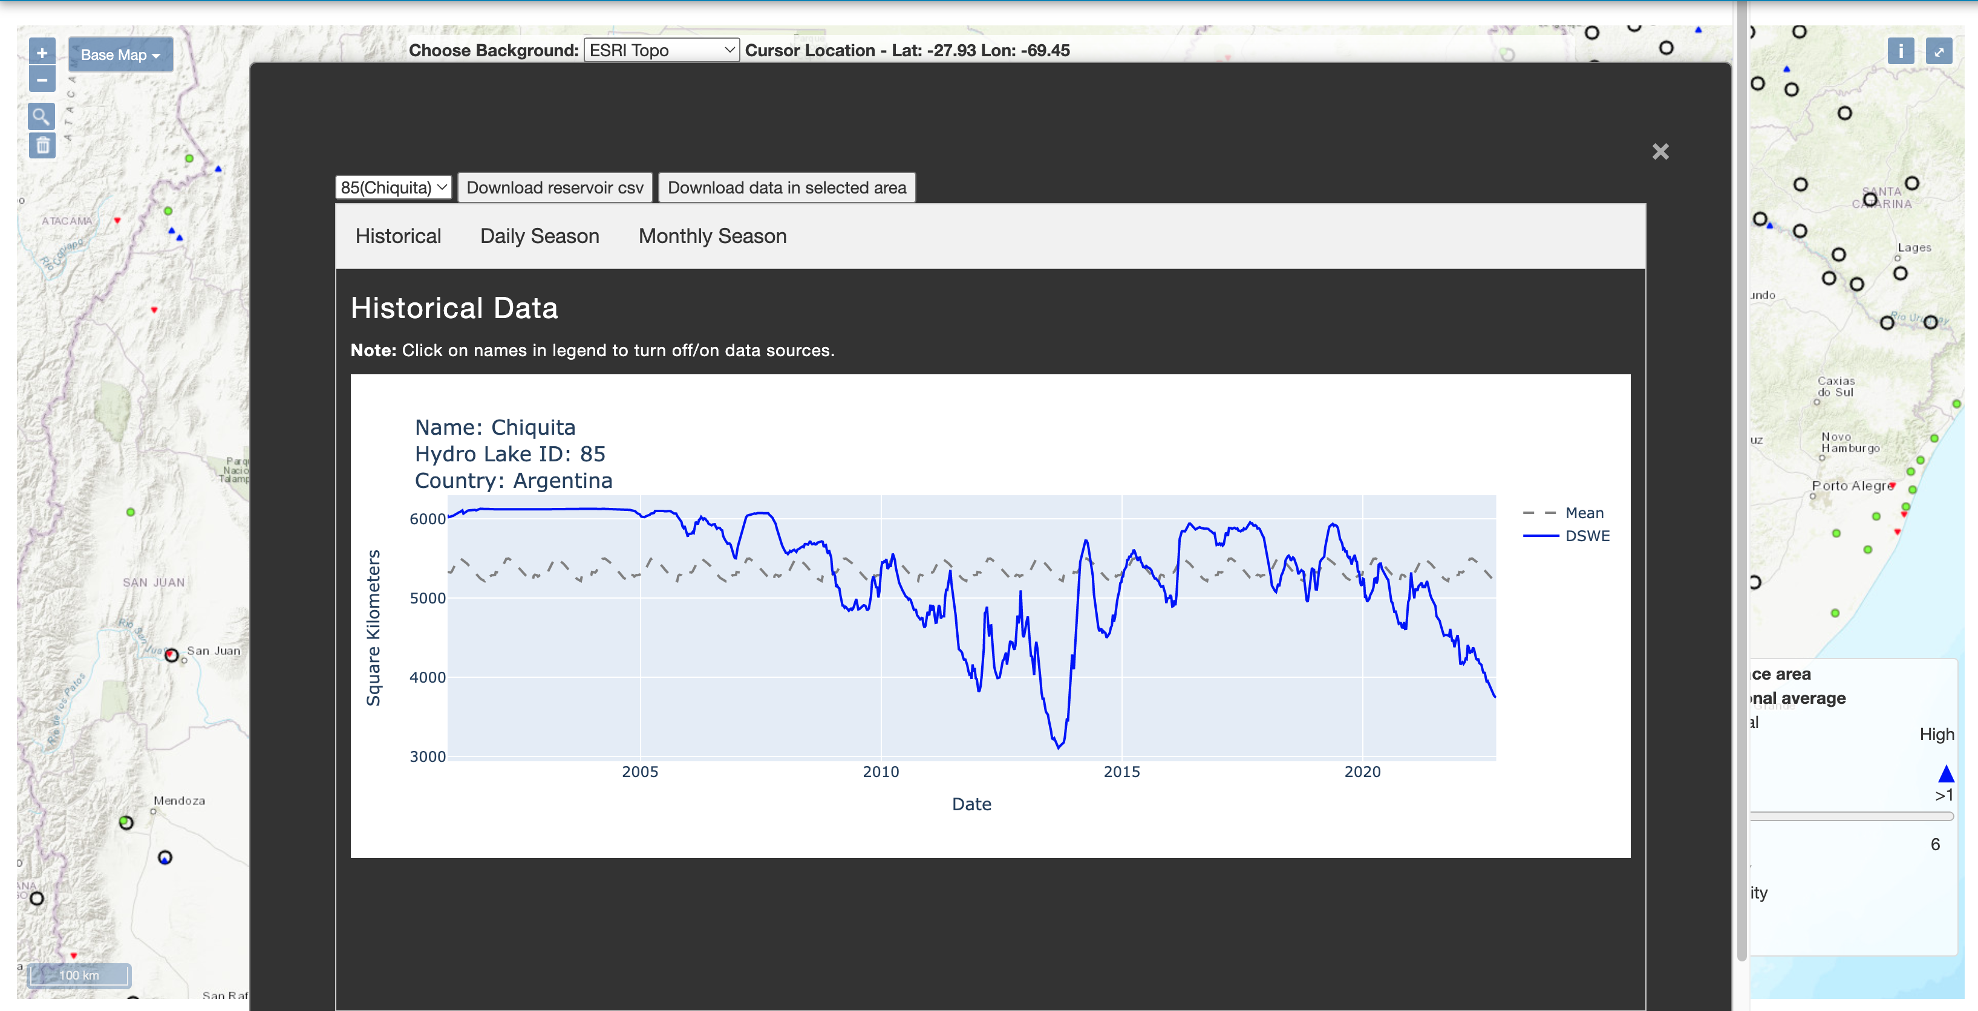
MOGWAI
MOGWAI Historical Assessments of Lake/Reservoirs
Notes:
Reservoir and lake assessment module allows for automated delineation of surface water extent and tracks variability over time.
Joint effort between ERDC and National Geospatial-Intelligence Agency (NGA)
Two validated algorithms apply different approaches to water pixel classification on MODIS imagery
Independently assessed by United States Geological Survey (USGS)
Temporal profile (time series) of surface water extent/area enhanced by dynamically updating current estimates as new imagery becomes available
This provides historical and near real-time (~8-day latency) information regarding reservoir stocks around the world.

Slide 12
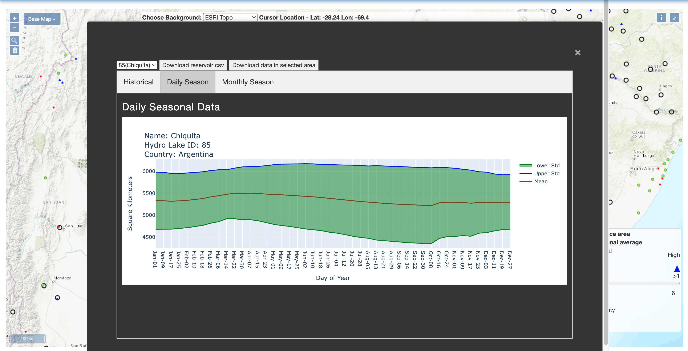
MOGWAI
MOGWAI Statistical Evaluation of Lake/Reservoirs (Daily Seasonal)
Notes:
Reservoir and lake assessment module allows for automated delineation of surface water extent and tracks variability over time.
Joint effort between ERDC and National Geospatial-Intelligence Agency (NGA)
Two validated algorithms apply different approaches to water pixel classification on MODIS imagery
Independently assessed by United States Geological Survey (USGS)
Temporal profile (time series) of surface water extent/area enhanced by dynamically updating current estimates as new imagery becomes available
This provides historical and near real-time (~8-day latency) information regarding reservoir stocks around the world.

Slide 13
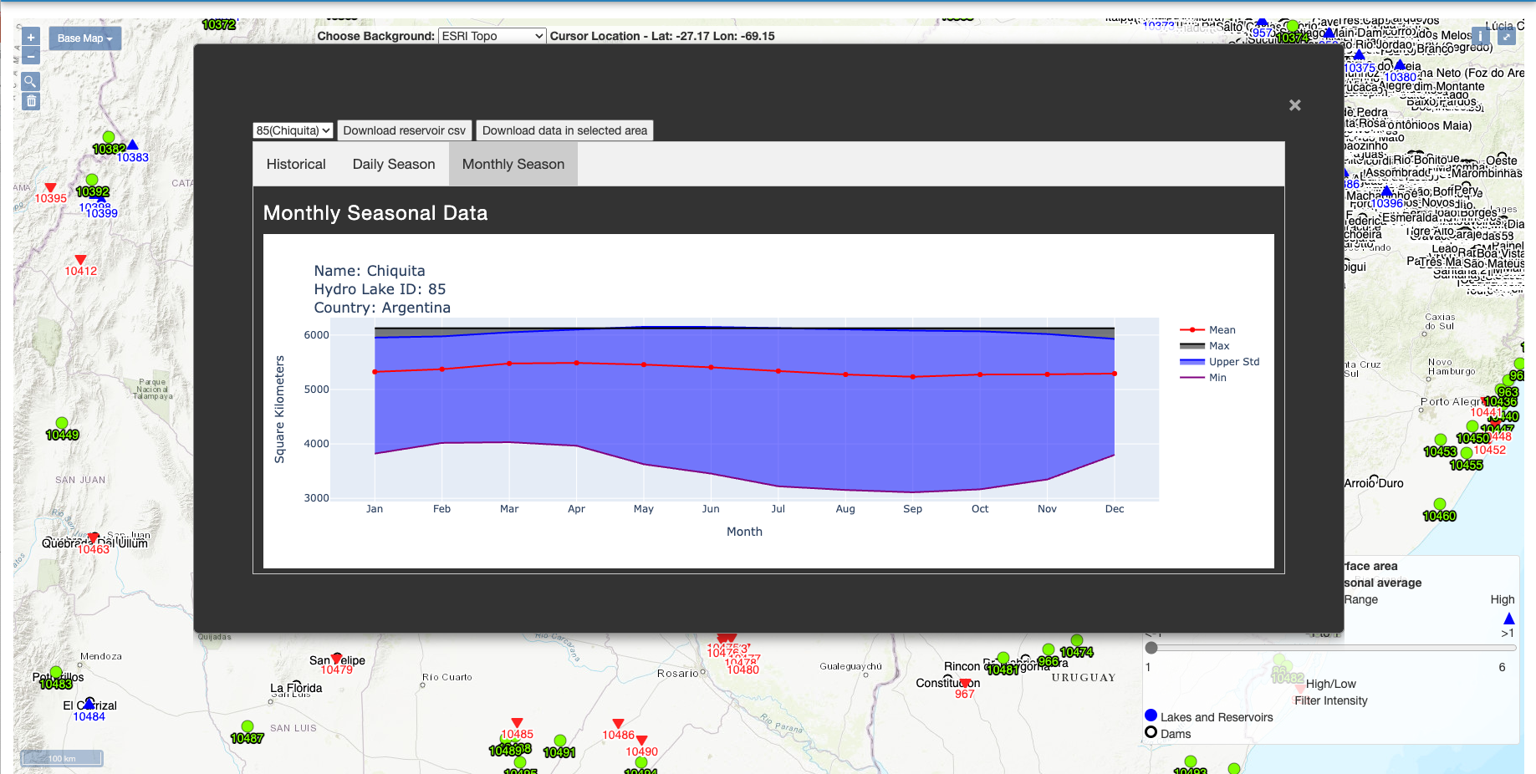
MOGWAI Statistical Evaluation of Lake/Reservoirs (Monthly Seasonal)

